Slide 1
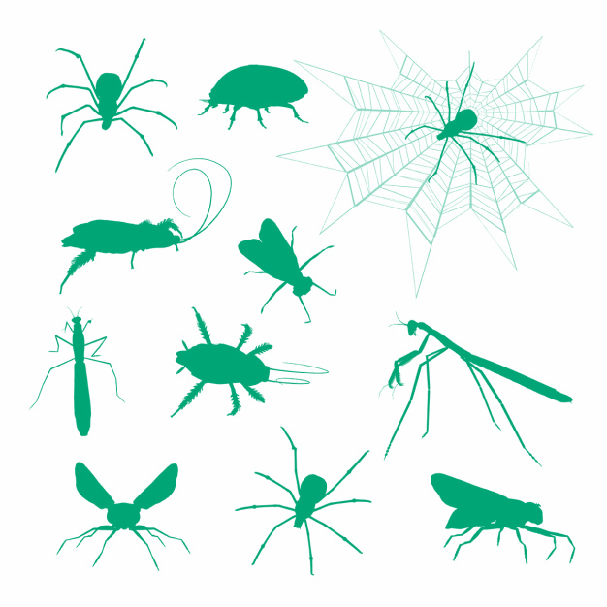
INSECTOPHAGIA

Slide 2
Synopsis and presentation of the game
You decide to farm insects for human consumption to offer a ready made product to your future customers.
So you create your business and start your project.
Will you be able to make the right choices, find the right arguments to convince your investors and customers, and raise the biggest launch budget while adopting a logic of sustainable development?

Slide 3
Create an advertising spot and / or a packaging
Level 3 : THE SALE
Level 2 : PRODUCTION
Make a poster justifying the choices of the company
Level 1 :
THE GENESIS OF THE COMPANY
Make a file presenting the project and the company

Slide 4
Play equipment
The Student game book will allow you to keep track of your project.
You will note the progress in the game, you will find help to obtain grants and protection cards.
"Events of the Day" cards: All players must bow to the day's event.
"Protection" cards: They allow to counter negative random events or to facilitate your progress in the game. To obtain them, you have to take up challenges.
These cards are marketable, you can buy them to other groups, sell them or exchange them.
Badges table: Badges are used to obtain money and protection cards. If you have three badge levels, you get a protection card (in addition to the money).
The Game platform : The platform makes it possible to follow the acquisition of the badges as well as the scores (money and gauges sustainable development) as you advance in the game.
http://jenlab.iut-laval.univ-lemans.fr/login/index.php

Slide 5
Rules of the game
The players : The 3 or 4 members of the company.
A "Master Game ": manages the course of the game, distributes cards and assigns badges, money and sustainable development points.
A "Superhero": can help you but if you ask him a question ... you have to be ready to pay for his services !!

Slide 6
How to win?
Being the most sustainable company: balancing development gauges
sustainable development (Environment, Economy, Social).
Being the company that raises the most money to finance his project.
At each level, you must complete several missions.
These missions are presented as challenges to be met.
At every challenge you can get sustainable development points and make money.
You can also win protection cards (if you validate two levels of
badges).

Slide 7
Level 1: The genesis of the company
Goal of the level
Objective: to make a file presenting the project and the company
Modalities: fulfill the different missions.
Depending on how successful you are, you'll be able to get badges, protection cards, sustainable development points and money.

Slide 8
To succeed the level
The team is welded
The project is part of the logic of sustainable development: respect for the 3 pillars
The project is built (production needs, market knowledge) with a clear objective (added value = what the company creates)
The company is creative (name, slogan, logo)

Slide 9
Mission 1: State of play - Insect family
Snooping Challenge:
Validate the sneaking badge
- Shoot an "insect family" card
- Create a category or a table on Pinterest (https://fr.pinterest.com/) with the name of the insect family drawn and add 2 links (make 2 websites that you deem relevant and reliable)
Validate the sneaking badge
 | Beginner | In Pinterest provide a relevant and reliable link on your insect family. justifying it with a short description and at least 3 keywords describing the content.* orally you will give three criteria of reliability
 | Intermediate | In Pinterest provide a second relevant and reliable link on your insect family. justifying it with a short description and at least 3 keywords describing the content.* orally you will give three criteria of reliability
 | Expert | In Pinterest create a table containing your links and share it and with another team that will evaluate it

Slide 10
Mission 2: Choosing the Insect
Challenge marmite of Insects :
- In your table created on Pinterest, add 3 links that allowed you to choose your insect
- In the websites selected above, you must be able to find information to answer several questions (validate the insects' cooking pot badge)
 | Fast food | Answer the following questions :how many legs to your insect ? At what stage of development can we taste it ?
 | Road menu | Answer the following questions describe the taste of your insecthow does it cook?
 | Gourmet menu | Correctly answer the following question:what is the nutritional interest of the chosen insect?

Slide 11
Mission 3: Creation of the company
Challenge marmite of Insects :
Realize a document (Powerpoint, Prezi ...) presenting the company and respecting the specifications below:
Tasks to be performed | € | Environment (respect for nature) | Economic (efficiency) | Social (health, employment)
1/ Identify what the company creates | 1000
2/ Define the identity of the company | 5000
Company Name | 1000 | + 1 | + 1 | + 1
Target audience | 1000
Logo | 1000 | + 1 | + 1 | + 1
Slogan | 1000 | + 1 | + 1 | + 1
Project |  | until + 3 | until + 3 | until + 3
3/ List the needs of the company | 4000
Financial capital | 1000
Fixed capital = machinery, tools, buildings | 1000
Circulating capital = energy, raw materials | 1000
Work = employees (jobs, working conditions) | 1000
MAX TOTAL | 10 000 | + 6 | + 6 | + 6

Slide 12
Mission 4: Oral Presentation
Convince the master of the game and the superhero, with the arguments of previous missions, the relevance and viability of the project to obtain funding
Ask questions highlighting your competitors' weaknesses
At the end of this level: You can view acquired badges, see the number of sustainable development points obtained as well as the money collected on the points counting platform.

Slide 13
Level 2 : Production
Goal of the level
Objective: to make a poster justifying the choices of the company (location, energy)
Modalities: Choices respect sustainable development and are relevant because they are well adapted to the project
Each choice (energy and location) is documented and
argued
The poster is original and convincing

Slide 14
Mission 1: Choosing the location of the company
Geography Challenge:
Identify on a map the location you want to implement your business. Make sure that it respects the main conditions:
- A safe and secure location for your business (see PLU)
- A relevant and sustainable location for your business (see IGN maps
and risk map)
→ Validate the geographer badge
Go to the field to visit the plots you have spotted
On each parcel, measure using the gift
Make a video tutorial explaining how the device works and post it on Youtube
→ Validate the metrology badge
Metrology Challenge:

Slide 15
 | Star dust | make a video tutorial explaining how your gift works 2 parameters explained
 | Prince of the wind | 3 parameters explained
 | Snow Queen | 4 parameters explained
Make a choice of location: To make your choice, cross the collected geographical and metrological data If the chosen location is sustainable (environmentally friendly, neighborhood, is easily serviced and has good conditions) you get points of sustainable development

